Slide 1



s
e
c
o
n
d
C
O
R
N
A
N
I
T
H
I
S
3.1-18
A free CD of this message will be available following the service
It will also be available for podcast later this week at calvaryokc.com

Slide 2
Phil. 3:4-9 - ⁴ though I also might have confidence in the flesh. If anyone else thinks he may have confidence in the flesh, I more so: ⁵ circumcised the eighth day, of the stock of Israel, of the tribe of Benjamin, a Hebrew of the Hebrews; concerning the law, a Pharisee; ⁶ concerning zeal, persecuting the church; concerning the righteousness which is in the law, blameless.
O
A
N
S
3.1-18
I
I
s
e
c
o
n
d
C
R
N
T
H

Slide 3
Phil. 3:4-9 - ⁷ But what things were gain to me, these I have counted loss for Christ. ⁸ Yet indeed I also count all things loss for the excellence of the knowledge of Christ Jesus my Lord, for whom I have suffered the loss of all things, and count them as rubbish, that I may gain Christ.
Have counted (v. 7) - perfect tense - once for all not repeated
Also count - present tense
Loss - zēmioō – also translated damage
Rubbish - KJV, Dung
O
A
N
S
3.1-18
I
I
s
e
c
o
n
d
C
R
N
T
H

Slide 4
Phil. 3:4-9 - and be found in Him, not having my own righteousness, which is from the law, but that which is through faith in Christ, the righteousness which is from God by faith;
O
A
N
S
3.1-18
I
I
s
e
c
o
n
d
C
R
N
T
H

Slide 5
O
A
N
S
3.1-18
I
I
s
e
c
o
n
d
C
R
N
T
H

Slide 6
The
A
new covenant - no definite article
O
A
N
S
3.1-18
I
I
s
e
c
o
n
d
C
R
N
T
H

Slide 7
O
A
N
S
3.1-18
I
I
s
e
c
o
n
d
C
R
N
T
H

Slide 8
Rom. 2.28-29 - ²⁸ For he is not a Jew who is one outwardly, nor is circumcision that which is outward in the flesh; ²⁹ but he is a Jew who is one inwardly; and circumcision is that of the heart, in the Spirit, not in the letter; whose praise is not from men but from God.
O
A
N
S
3.1-18
I
I
s
e
c
o
n
d
C
R
N
T
H

Slide 9
Rom. 7:6 - But now we have been delivered from the law, having died to what we were held by, so that we should serve in the newness of the Spirit and not in the oldness of the letter.
Not the Letter of
but
The Law
Vs.
the spirit
Of The Law
O
A
N
S
3.1-18
I
I
s
e
c
o
n
d
C
R
N
T
H

Slide 10
O
A
N
S
3.1-18
I
I
s
e
c
o
n
d
C
R
N
T
H

Slide 11
Existentialist - “One who adheres to the philosophy that emphasizes the uniqueness and isolation of the individual experience”
Libertine - “One who acts without moral restraint; a dissolute person.”
O
A
N
S
3.1-18
I
I
s
e
c
o
n
d
C
R
N
T
H

Slide 12




“The Holy Spirit moved so much last night the Preacher
never even opened
the Bible”
“if it feels good, do it!
If it itches, scratch it!”
Radical
Living
Outlined
Empowered
By the Word
by the Spirit
of God
of God
Existentialist
Spirit-filled living
Libertine
O
A
N
S
3.1-18
I
I
s
e
c
o
n
d
C
R
N
T
H

Slide 13
Calvary Chapel Ongata Rongai (Kenya) - “A small church that believes in a big God”
“Making disciples one verse at a time”
O
A
N
S
3.1-18
I
I
s
e
c
o
n
d
C
R
N
T
H

Slide 14
O
A
N
S
3.1-18
I
I
s
e
c
o
n
d
C
R
N
T
H

Slide 15
Moses had
We can have
Communion with God
O
A
N
S
3.1-18
I
I
s
e
c
o
n
d
C
R
N
T
H

Slide 16
O
A
N
S
3.1-18
I
I
s
e
c
o
n
d
C
R
N
T
H

Slide 17
NLT - In fact, that first glory was not glorious at all compared with the overwhelming glory of the new way.
O
A
N
S
3.1-18
I
I
s
e
c
o
n
d
C
R
N
T
H

Slide 18
O
A
N
S
3.1-18
I
I
s
e
c
o
n
d
C
R
N
T
H

Slide 19
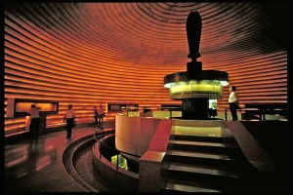
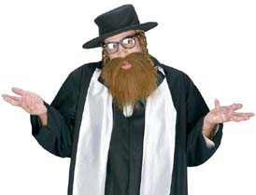
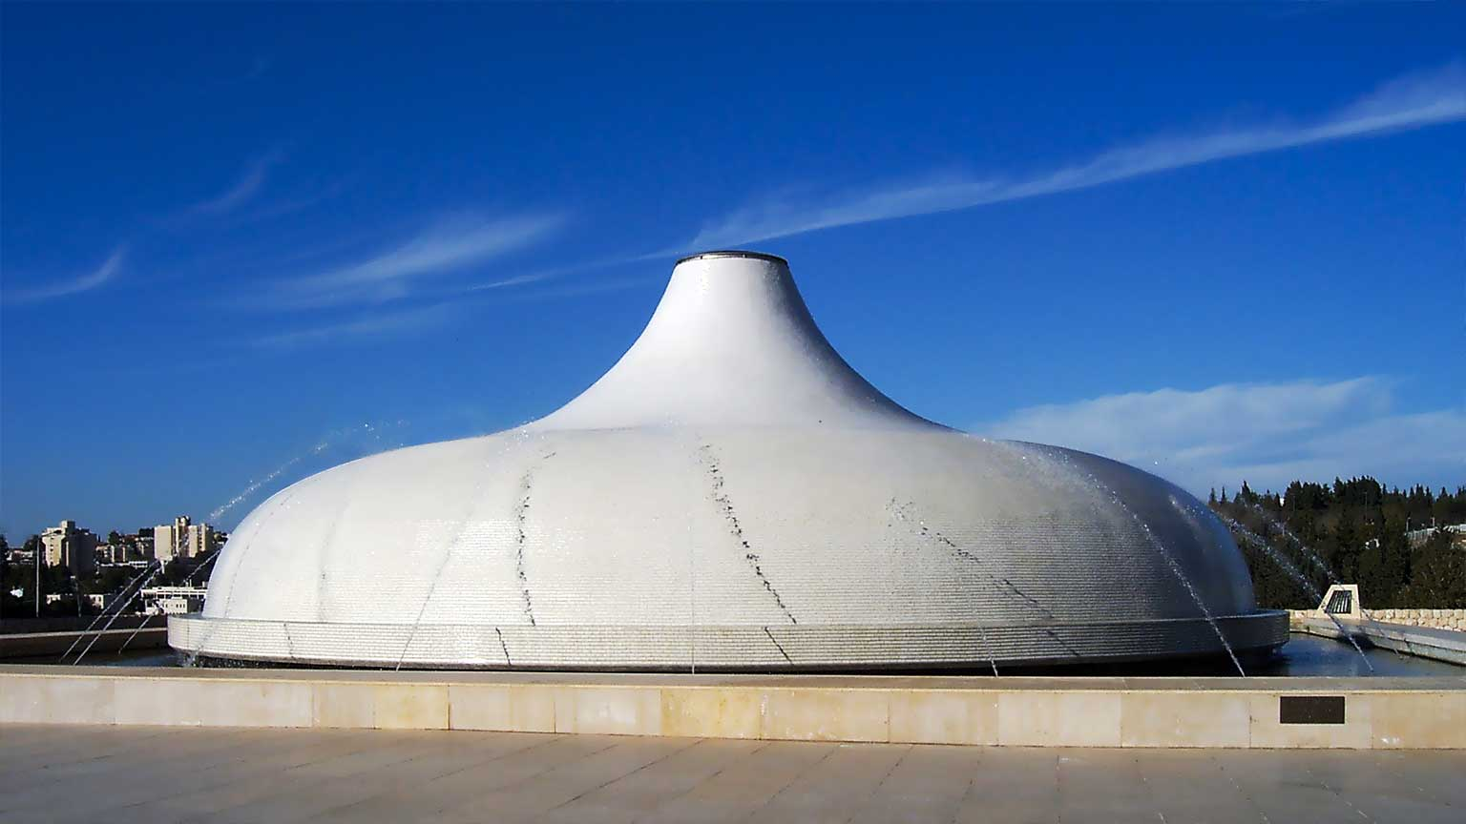
f
f
Isaiah “A” Scroll
Shrine of the Book
O
A
N
S
3.1-18
I
I
s
e
c
o
n
d
C
R
N
T
H

Slide 20
O
A
N
S
3.1-18
I
I
s
e
c
o
n
d
C
R
N
T
H

Slide 21
The
Broad
road
The
Narrow
Road
O
A
N
S
3.1-18
I
I
s
e
c
o
n
d
C
R
N
T
H

Slide 22
O
A
N
S
3.1-18
I
I
s
e
c
o
n
d
C
R
N
T
H

